Slide 1

RESTful web APIs & Multithreading
Bytedance Android Developer: Enlong Xia

Slide 2

You will learn
Web Basics
Data formats
Android Multithreading
Fetch data for you Android App

Slide 3
Web services to access data
Many apps access data through a web layer
Client (app) makes queries by contacting certain specific URLs
Server (web URL) sends the appropriate data back
Client parses the data, displays it, etc.

Slide 4
Web services
Web service: a set of functionality offered over a server using the web, but not web pages / HTML
Use the web’s HTTP protocol to connect and transfer data
Client connects to specific URLs to request specific data, which is then sent back in some documented format as XML or JSON
REST: Representational State Transfer. Common style of web services
“RESTful web services” or “RESTful APIs”
Notes:
划重点，后面要用到

Slide 5
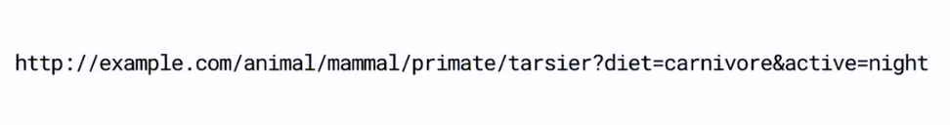
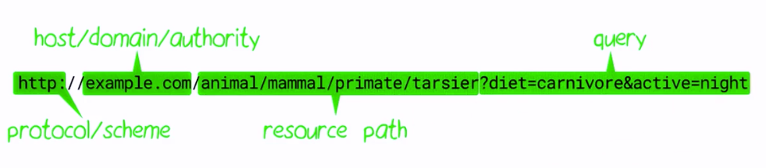
HTTP URL

Slide 6
RESTful web services
Style Guide
Uniform Resource Identifier (URI) | GET | PUT | PATCH | POST | DELETE
Collection, such as https://api.example.com/resources/ | List the URIs and perhaps other details of the collection's members. | Replace the entire collection with another collection. | Not generally used | Create a new entry in the collection. The new entry's URI is assigned automatically and is usually returned by the operation. | Delete the entire collection.
Element, such as https://api.example.com/resources/item5 | Retrieve a representation of the addressed member of the collection, expressed in an appropriate Internet media type. | Replace the addressed member of the collection, or if it does not exist, create it. | Update the addressed member of the collection. | Not generally used. Treat the addressed member as a collection in its own right and create a new entry within it.^{[17]} | Delete the addressed member of the collection.
REST - wikipedia
Restapitutorial
HTTP methods for RESTful Services

Slide 7
Data Formats
Suppose we have an API that returns a list of employees:
There are two employees, Alex and Bob. Alex’s job is developer and Bob’s is tester.
Alex is familiar with Python, C/C++ and pascal; Bob is familiar with lisp, FORTRAN, and REST APIs.
How do we represent such data?

Slide 8
Data Formats
YAML
XML
JSON
# Employee Records
- Employee one:
name: Alex
job: Developer
skills:
- python
- C/C++
- pascal
- Employee two:
name: Bob
job: Tester
skills:
- lisp
- FORTRAN
- REST APIs
<?xml version="1.0"?>
<EmployeeRecord>
<Employee id="emp01">
<name>Alex</name>
<job>Developer</job>
<skills>python, C/C++, pascal</skills>
</Employee>
<Employee id="emp02">
<name>Bob</name>
<job>Tester</job>
<skills>lips, FORTRAN, REST APIs</skills>
</Employee>
</EmployeeRecord>
{
"Employees": [
{
"id": "emp01",
"name": "Alex",
"job": "Developer",
"skills": "python, C/C++, pascal"
},
{
"id": "emp02",
"name": "Bob",
"job": "Tester",
"skills": "lisp, FORTRAN, REST APIs"
}
]
}
Notes:
问题：
YAML 是 JSON 的超集，能表示的含义更多，这也带来一个坏处就是解析性能比 JSON 差

Slide 9
JSON format
JavaScript Object Notation
The most common response format
Easy for humans to read and write
Easy for machines to parse and generate
Language-independent
vs XML, vs YAML（Tutorial）

Slide 10
RESTful web services
Examples
Github API
The Guardian
Chuck Norris
The Cat Api
URLs in your browser

Slide 11
JSON Data Types
In JSON, values must be one of the following data types:

Slide 12
JSON Data Types
JSON strings
"John"
JSON Numbers, integer or float
30
JSON Arrays
[ "John", "Anna", "Peter" ]
JSON Booleans
true
JSON null
null
JSON Objects
{ "name":"John", "age":30, "city":"New York" }
{"employee":{ "name":"John", "age":30, "city":"New York" }}

Slide 13
JSON Data Types
Example data, try to create JSON:
temp
min = 11.34
max = 19.01
weather
id = 801
condition = Clouds
description = null
success = true
notification_user = Adam, Bob, John

Slide 14
JSON Data Types
{
"temp": {
"min": 11.34,
"max": 19.01
},
"weather": {
"id": 801,
"condition": "Clouds",
"description": null
},
"success": true,
"notification_user_id": [
"Adam",
"Bob",
"John"
]
}

Slide 15
Break
Download postman and register
Fetch code (git repo)
Find third_party_json_api under misc
Q & A

Slide 16
Request Third Party APIs practice
Simple GET requests: in third_party_json_api file
Json prettify
Postman
Request picture in last response

Slide 17
RESTful APIs on the Android platform
JSON lib
org.json.JSONObject
Gson
HTTP lib
HttpUrlConnection
Retrofit

Slide 18
org.json.JSONObject
Doc
{
"os": [
{
"name": "Pie",
"code": 28
},
{
"name": "Oreo",
"code": 27
}
]
}
public static String RAW =
"{\"os\":[{\"name\":\"Pie\",\"code\":28}," +
“{\"name\":\"Oreo\",\"code\":27}]}";
JSONObject root = new JSONObject(RAW);
JSONArray os = root.optJSONArray(“os”);
result = os.optJSONObject(0).
optString("name");

Slide 19
Gson
public class OSList {
AndroidOS[] os;
}
public class AndroidOS {
@SerializedName("name")
String name;
@SerializedName("code")
int code;
}
OSList list = new Gson()
.fromJson(RAW, OSList.class);
String result =
list.getOs()[0].getName();
Github
{
"os": [
{
"name": "Pie",
"code": 28
},
{
"name": "Oreo",
"code": 27
}
]
}

Slide 20
Before HTTP Connection
Request Internet permissions in your AndroidManifest.xml
<manifest xmlns:tools="http://schemas.android.com/tools"
package="com.bytedance.android.lesson.restapi"
xmlns:android="http://schemas.android.com/apk/res/android">
<uses-permission android:name="android.permission.INTERNET" />
<uses-permission android:name="android.permission.ACCESS_NETWORK_STATE" />
<application
...
</application>
</manifest>

Slide 21
HttpURLConnection
Doc
if (urlConnection != null) {urlConnection.disconnect();}
if (in != null) {
try {in.close();}
catch (IOException e) {e.printStackTrace();}
}
}
return result;
}
private static String readStream(final InputStream inputStream) {
final Scanner scanner = new Scanner(inputStream);
scanner.useDelimiter("\\A");
final String data = scanner.next();
return data;
}
public static String getResponseWithHttpURLConnection(String url) {
String result = null;
InputStream in = null;
HttpURLConnection urlConnection = null;
try {
URL netUrl = new URL(url);
urlConnection = (HttpURLConnection) netUrl.openConnection();
in = new BufferedInputStream(urlConnection.getInputStream());
result = readStream(in);
} catch (IOException e) {
e.printStackTrace();
} finally {

Slide 22
HttpURLConnection
Doc
URL netUrl = new URL(url);
urlConnection = (HttpURLConnection) netUrl.openConnection();
in = new BufferedInputStream(urlConnection.getInputStream());
result = readStream(in);
private static String readStream(final InputStream inputStream) {
final Scanner scanner = new Scanner(inputStream);
scanner.useDelimiter("\\A");
final String data = scanner.next();
return data;
}

Slide 23
Retrofit
Doc
// host, only once for one host
Retrofit retrofit = new Retrofit.Builder()
.baseUrl("http://api.icndb.com/")
.addConverterFactory(GsonConverterFactory.create())
.build();
// url
Response<Joke> response = retrofit.create(ICNDBService.class).randomJoke().execute();
return response == null ? null : response.body();
// definition
public interface ICNDBService {
@GET(“/jokes/random”) Call<Joke> randomJoke();
}

Slide 24
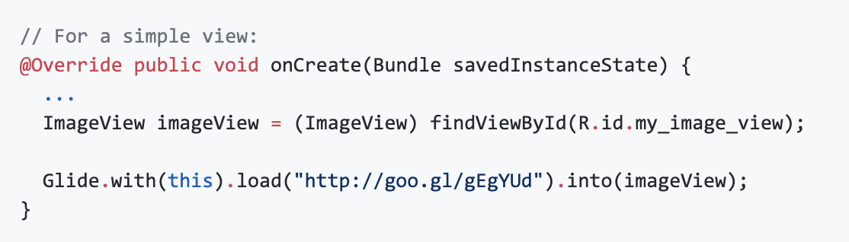
Glide
Doc

Slide 25
Break
Checkout Introducing_multithreading_and_retrofit
Run and check the result

Slide 26
Problems
What is NetworkOnMainThreadException? - google it!
NetworkOnMainThreadException doc
Do it on a worker thread
SecurityException? Connect to network doc
CalledFromWrongThreadException? try Retrofit async!
Why does it work?

Slide 27
Android Thread Model
Main Threads
1. Do not block the UI thread
2. Do not access the Android UI toolkit from outside the UI thread
Worker threads
Activity.runOnUiThread(Runnable)
View.post(Runnable)
View.postDelayed(Runnable, long)

Slide 28
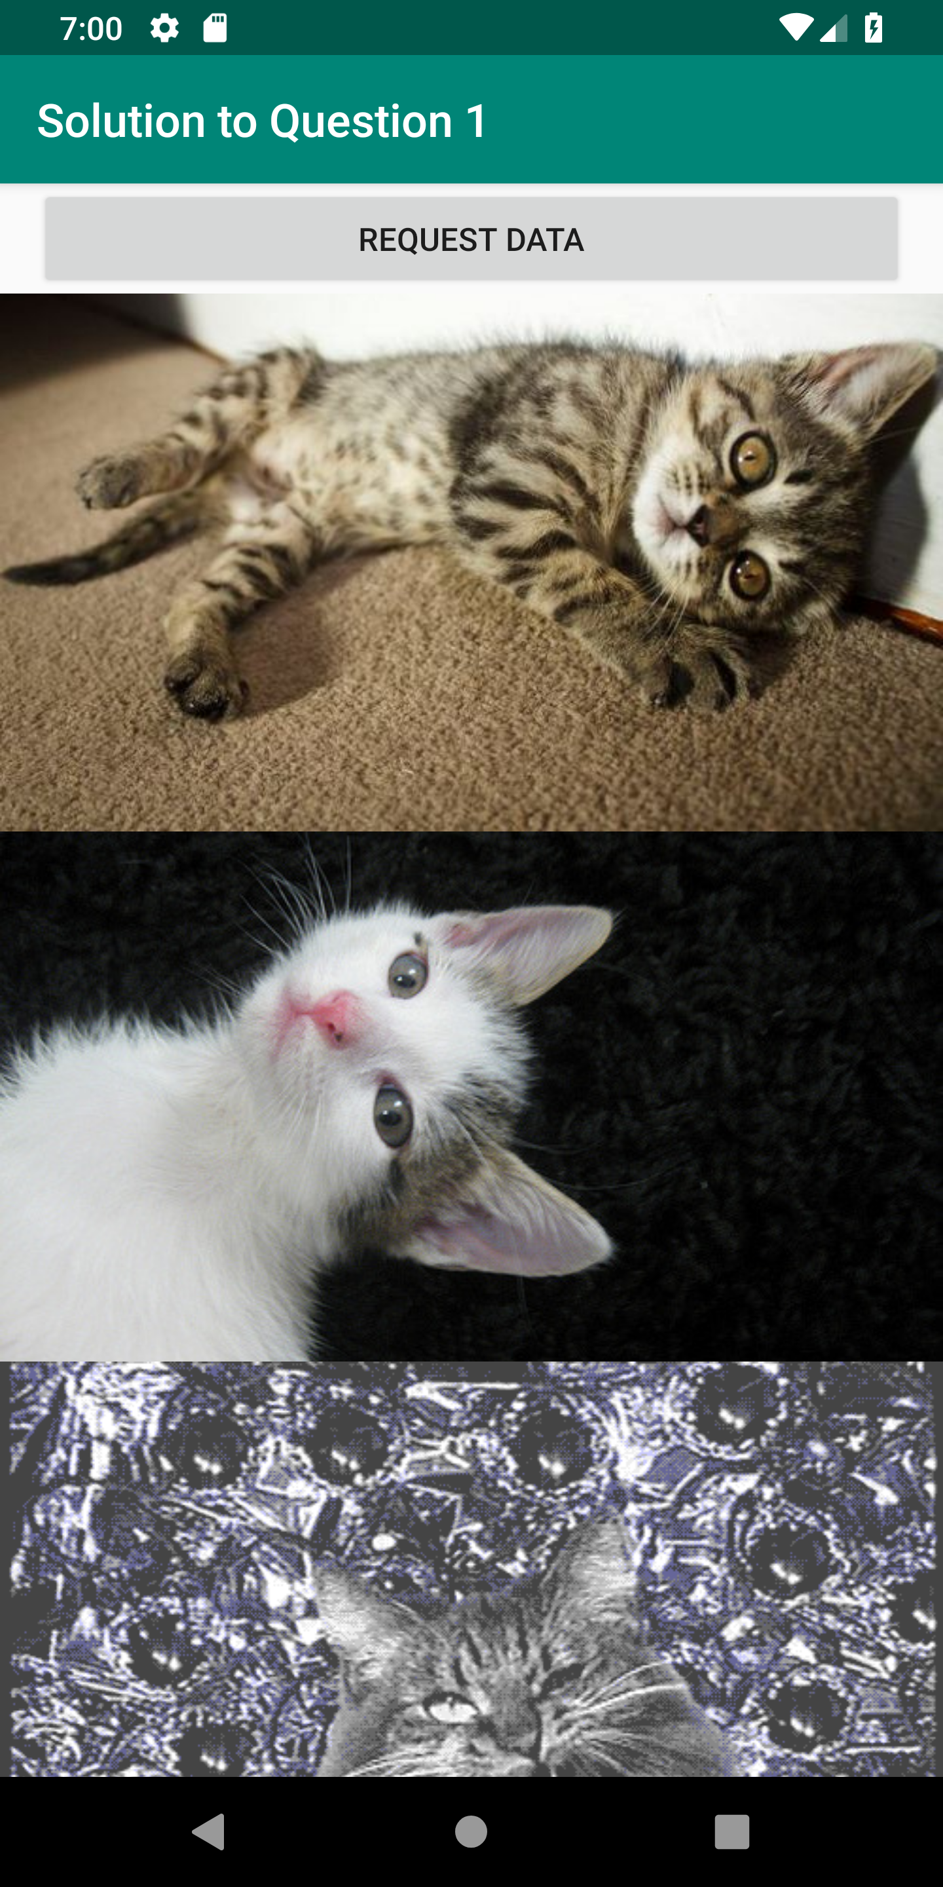
Classwork #1
Create App RandomCatPics, an Android App that requests TheCatApi for 5 random cat pictures and displays them, like:

Slide 29
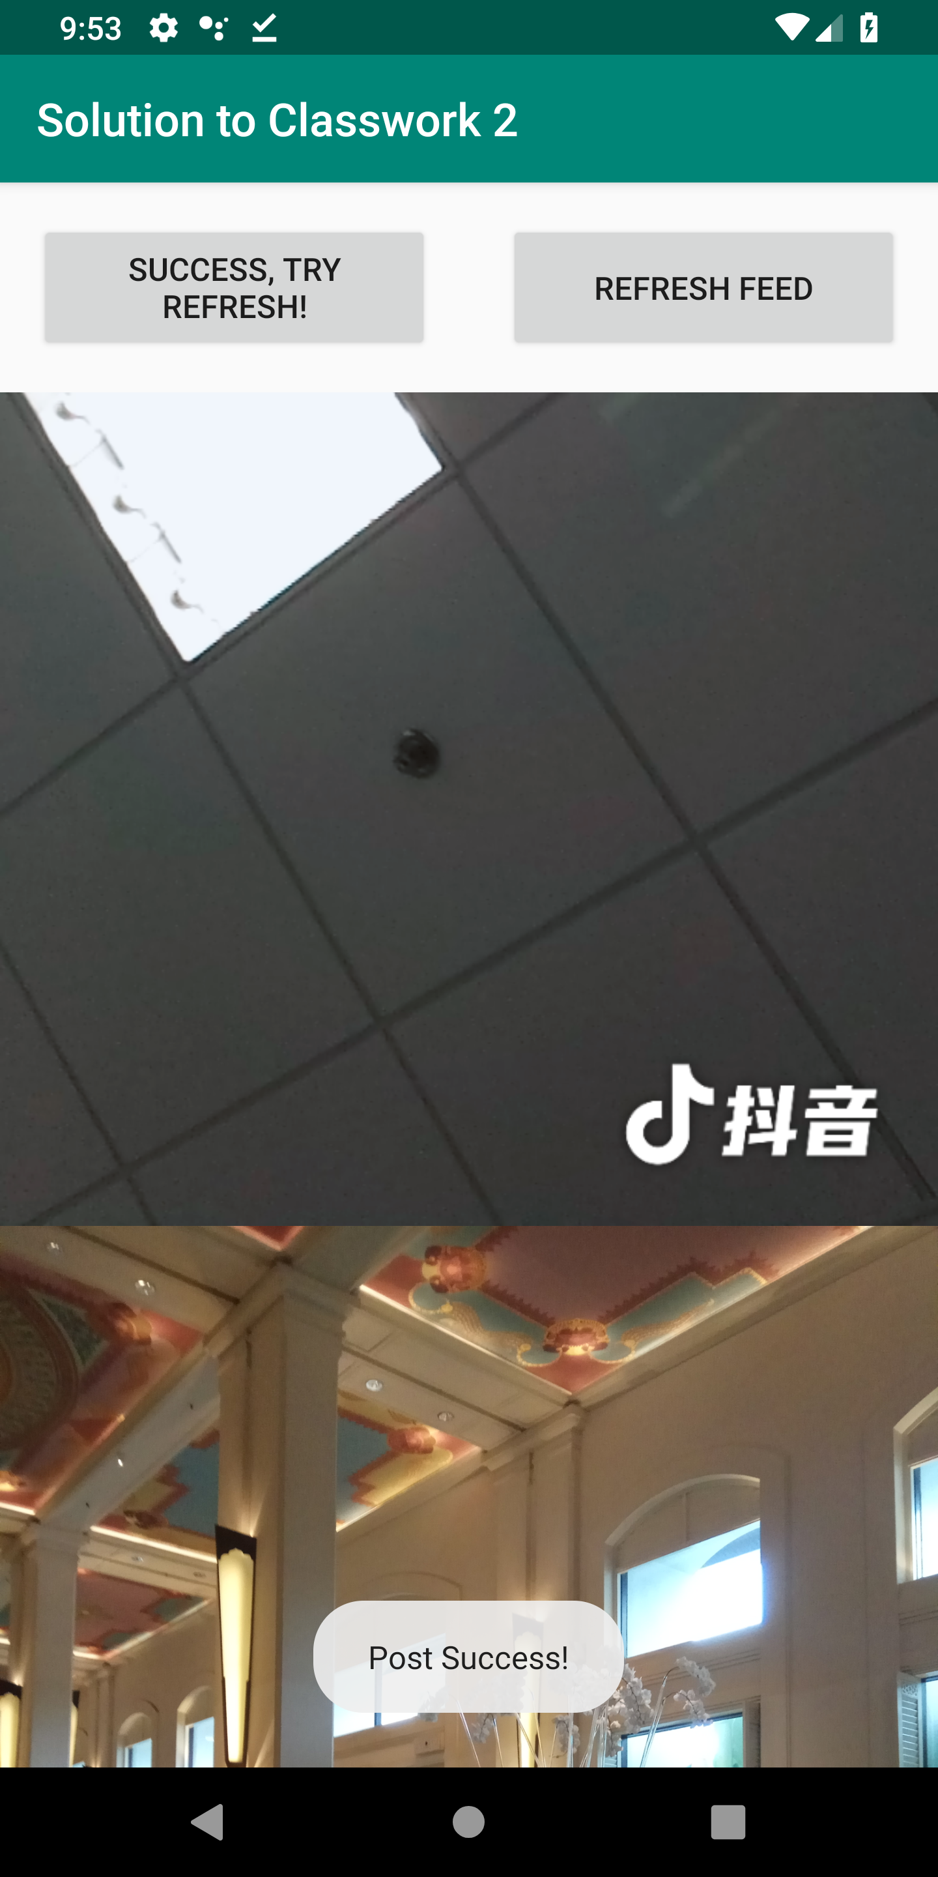
Classwork #2
Create App MiniDouyinApi, an Android App that can upload pictures from your album, request the “feed” interface for picture urls and display them as App RandomCatPics does.

Slide 30
Classwork #2 RESTful APIs
POST http://test.androidcamp.bytedance.com/mini_douyin/invoke/video
Parameters
Name | Type | Description
student_id | string | Required, e.g. 2220186666
user_name | string | Required, e.g. doudou
cover_image | file | Required.
video | file | Required.

Slide 31
Classwork #2 RESTful APIs
POST http://test.androidcamp.bytedance.com/mini_douyin/invoke/video
Response
{
"success": true,
"item": {
"student_id": "2220186666",
"user_name": "doudou",
"image_url": "https://sf6-hscdn-tos.pstatp.com/obj/developer-baas/baas/tt7217xbo2wz3cem41/9c6bbc2aa5355504_1560563154279.jpg",
"_id": "5d044dd222e26f0024157401",
"video_url": "https://lf1-hscdn-tos.pstatp.com/obj/developer-baas/baas/tt7217xbo2wz3cem41/a8efa55c5c22de69_1560563154288.mp4"
}
}

Slide 32
Classwork #2 RESTful APIs
GET http://test.androidcamp.bytedance.com/mini_douyin/invoke/video
Response
{"feeds": [
{
"student_id": "2220186666",
"user_name": "doudou",
"image_url": "https://sf6-hscdn-tos.pstatp.com/obj/developer-baas/baas/tt7217xbo2wz3cem41/9c6bbc2aa5355504_1560563154279.jpg",
"_id": "5d044dd222e26f0024157401",
"video_url": "https://lf1-hscdn-tos.pstatp.com/obj/developer-baas/baas/tt7217xbo2wz3cem41/a8efa55c5c22de69_1560563154288.mp4",
"createdAt": "2019-06-15T01:45:54.368Z",
"updatedAt": "2019-06-15T01:45:54.368Z"
}],
"success": true
}

Slide 33

THANKS.
Email: xiaenlong@bytedance.com WeChat: 18514698697

